Slide 1
Springboot and MicroServices

Slide 2
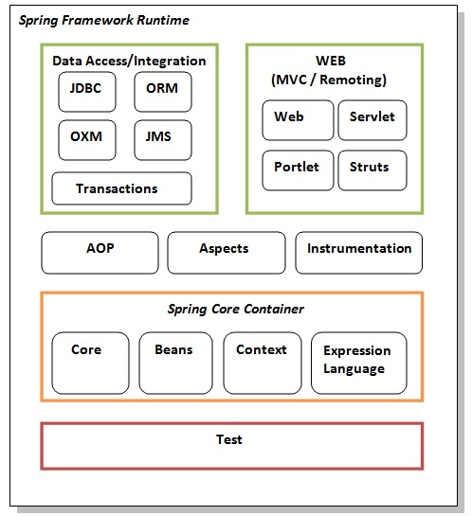
Spring
Spring Framework is a widely used Java EE framework for building applications.
Dependency Injection.
Applications/Features
Predefined Templates
Loose Coupling
Resource resource=new
ClassPathResource("applicationContext.xml");
BeanFactory factory=new XmlBeanFactory(resource);
Student student=(Student)factory.getBean("studentbean");

Slide 3
Spring MVC
Web MVC Framework for building web applications.
HTTP oriented.
configuration manually.
Specifies dependencies manually.
Takes more time to configure
Problem : Configuration.

Slide 4
Spring Boot
Spring Boot is a module of the Spring Framework. It is used to create stand-alone, Spring Based Applications with minimum efforts. It is developed on top of the core Spring Framework.
Spring Boot Framework is widely used to develop REST APIs.
Auto Configuration.
It also offers embedded servers, databases plugin.
Application.properties.
Spring boot Initializer.

Slide 5
Architecture
There are four layers in Spring Boot Architecture
Presentation Layer.
Business Layer.
Persistence Layer.
Database Layer.

Slide 6
Presentation Layer :
The presentation layer handles the HTTP requests, translates the JSON parameter to object, and authenticates the request and transfer it to the business layer. In short, it consists of views i.e., frontend part.
Business Layer
The business layer handles all the business logic. It consists of service classes and uses services provided by data access layers. It also performs authorization and validation.

Slide 7
Persistence Layer:
The persistence layer contains all the storage logic and translates business objects from and to database rows.
Database Layer: In the database layer, CRUD (create, retrieve, update, delete) operations are performed.

Slide 8
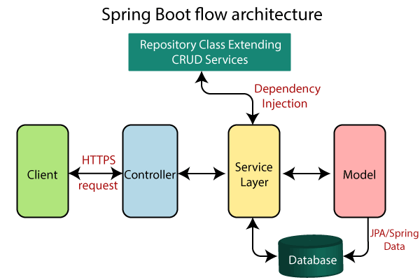

Slide 9
Annotations in Spring boot
@SpringBootApplication: @EnableAutoConfiguration,@ComponentScan, and
@Configuration.
@RequestMapping: It is used to map the web requests. It has many optional elements like consumes, header, method, name, params, path, produces, and value. Ex : @RequestMapping("/books") .
@Controller, @RestController, @GetMapping, @PostMapping, @PutMapping,
@DeleteMapping, @PatchMapping
Example :
@RequestMapping(path=“/getUsers”,method = RequestMethod.PATCH)

Slide 10
Annotations
@RequestBody and @ResponseBody.
@RequestParam
@PathVariable
@RequestHeader

Slide 11
Microservices
Microservices are the small services that work together.
For example, we can build a cloud application with the help of Amazon AWS with minimum efforts.

Slide 12
Monolithic and Microservices Architecture
Monolithic Architecture :
Monolithic application has single code base with multiple modules. Modules are divided as either for business features or technical features. It has single build system which build entire application.
Front-end
Business Logic
Database

Slide 13
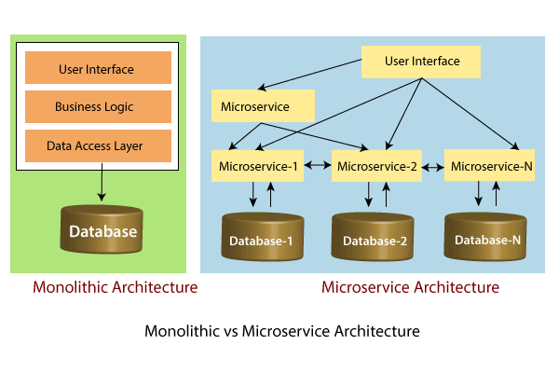

Slide 14
Advantages
Microservices are self-contained, independent deployment module.
The cost of scaling is comparatively less than the monolithic architecture.
Microservices are independently manageable services.
It is possible to change or upgrade each service individually rather than upgrading in the entire application.
Microservices allows us to develop an application which is organic (an application which latterly upgrades by adding more functions or modules) in nature.
The demanding service can be deployed on multiple servers to enhance performance.

Slide 15
Disadvantages
There is a higher chance of failure during communication between different services.
Difficult to manage a large number of services.
The developer needs to solve the problem, such as network latency and load balancing.

